Slide 1
IT-331 ( Computer Graphics 1)
Lecture 4
Circle - Generating Algorithms
Dr. Mohammed El-Said
Assistant Professor, Computer Science Dept.,
Faculty of Computers & Artificial Intelligence,
Helwan University - Cairo, Egypt.

Slide 2
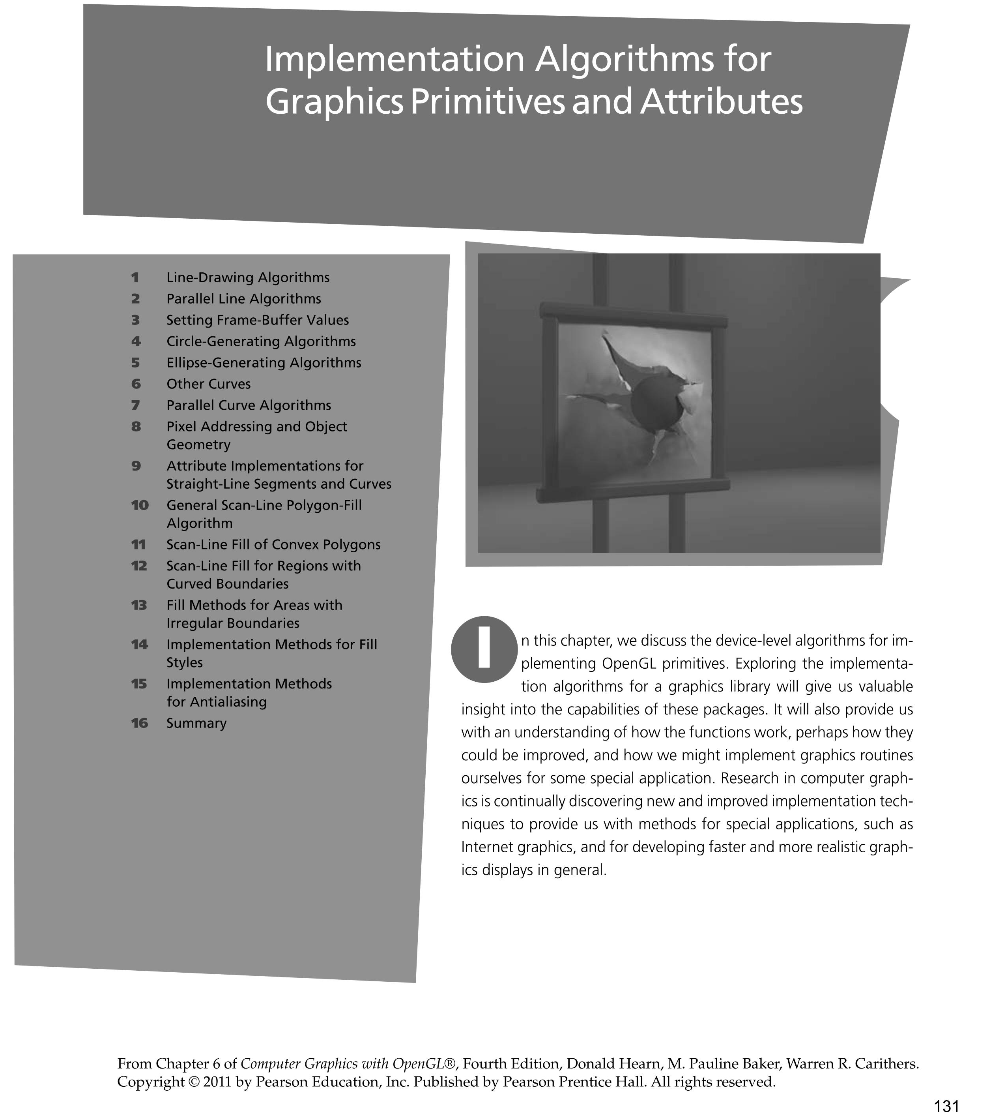

Slide 3
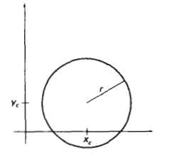
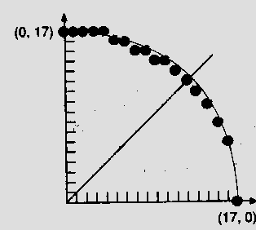
Scan Converting Circles
Explicit: y = f(x)
We could draw a quarter circle by incrementing x from 0 to R in unit steps and solving for +y for each step.
Method needs lots of computation, and gives non-uniform pixel spacing

Slide 4
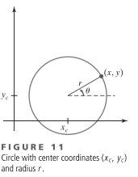
Scan Converting Circles
Parametric:
Draw quarter circle by stepping through the angle from 0 to 90
avoids large gaps but still unsatisfactory
How to set angular increment
Computationally expensive trigonometric calculations

Slide 5
Scan Converting Circles
Implicit: f(x,y) = x²+y²-R²
If f(x,y) = 0 then it is on the circle.
f(x,y) > 0 then it is outside the circle.
f(x,y) < 0 then it is inside the circle.
Try to adapt the Bresenham midpoint approach
Again, exploit symmetries

Slide 6
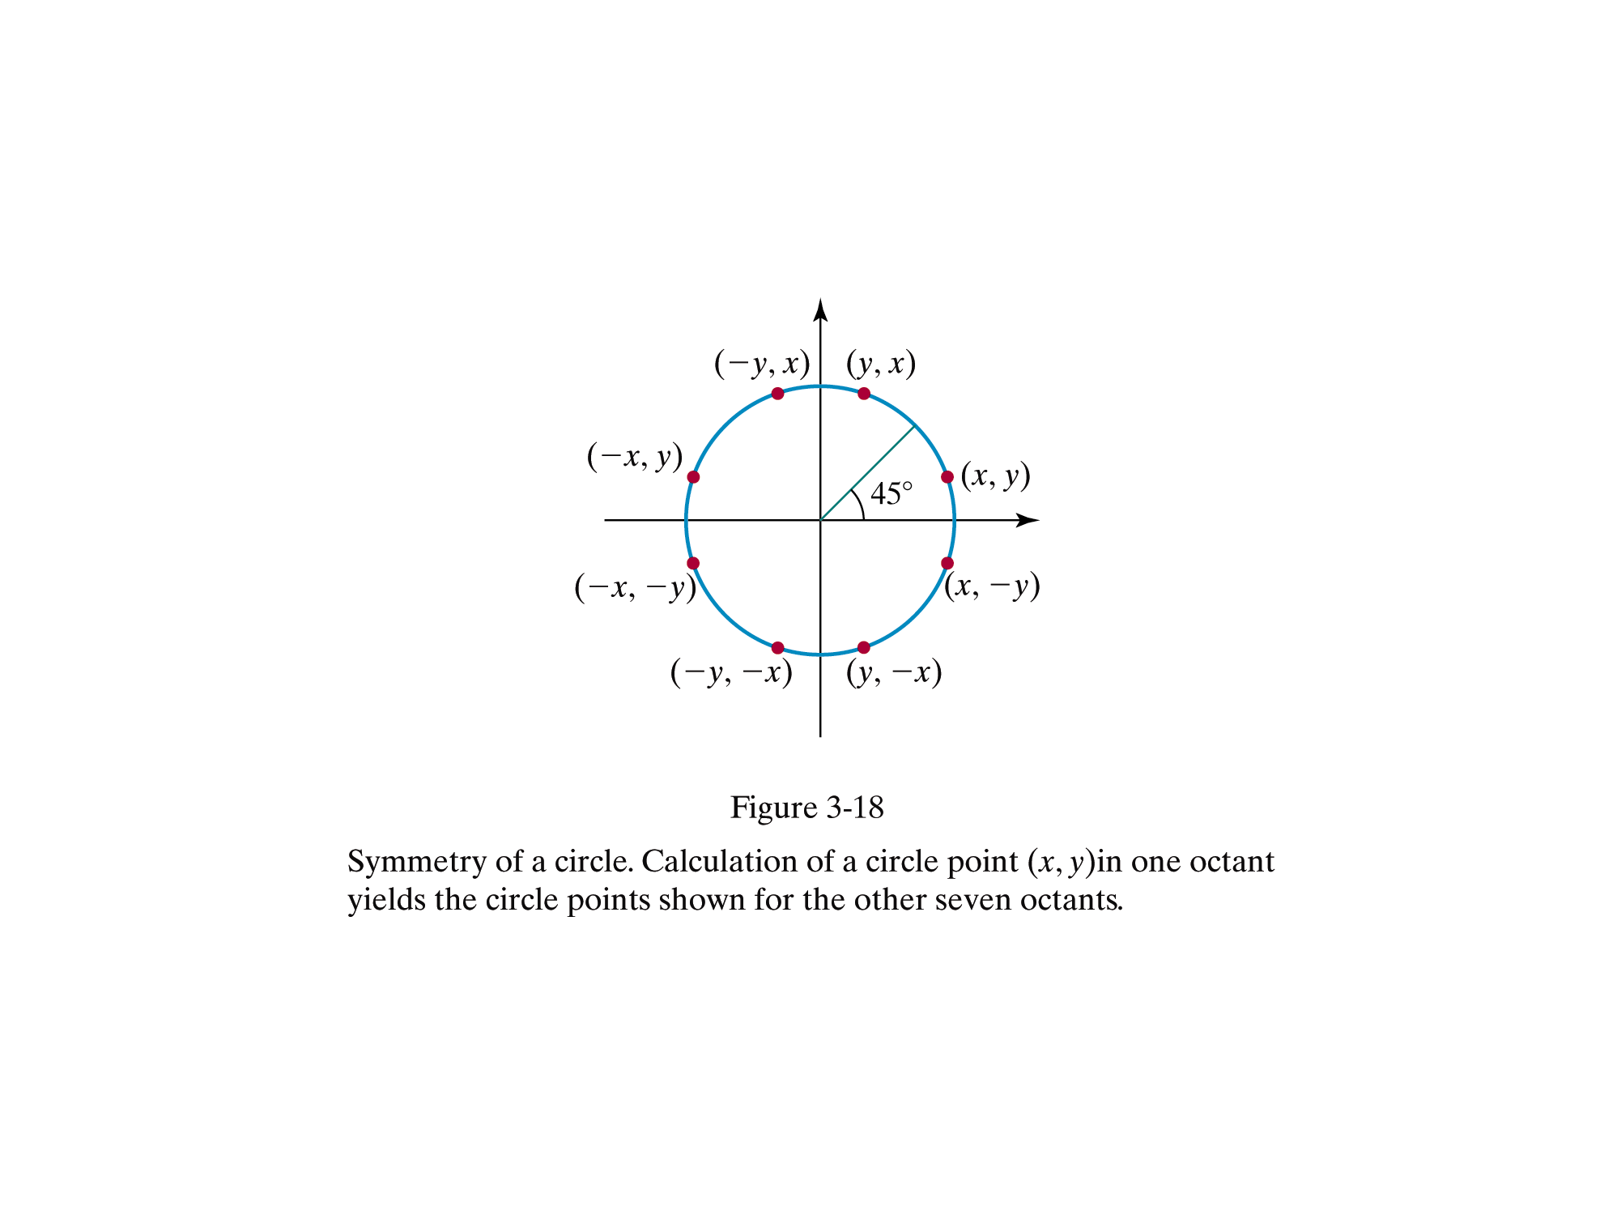

Slide 7
Generalising the Bresenham midpoint approach
Set up decision parameters for finding the closest pixel to the cırcumference at each sampling step
Avoid square root calculations by considering the squares of the pixel separation distances
Use direct comparison without squaring.
Adapt the midpoint test idea: test the halfway position between pixels to determine if this midpoint is inside or outside the curve
This gives the midpoint algorithm for circles
Can be adapted to other curves: conic sections

Slide 8
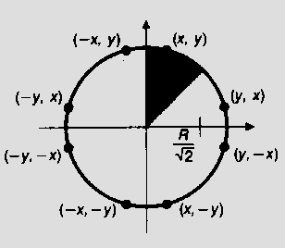
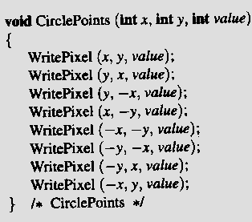
Eight-way Symmetry - only one octant’s calculation needed

Slide 9
The 2nd Octant is a good arc to draw
It is a well-defined function in this domain
single-valued
no vertical tangents: |slope|  1
Lends itself to the midpoint approach
only need consider E or SE
Implicit formulation F(x,y) = x ² + y ² – r ²
For (x,y) on the circle, F(x,y) = 0
F(x,y) > 0 ⇒ (x,y) Outside
F(x,y) < 0 ⇒ (x,y) Inside

Slide 10
Choose E or SE
Decision variable d is x ² + y ² – r ²
Then d = F(M) >= 0 ⇒ SE
Or d = F(M) < 0 ⇒ E

Slide 11
F (M) >= 0 ⇒ SE
current pixel
ideal curve

Slide 12
F (M) < 0 ⇒ E
ideal curve

Slide 13
Decision Variable p
As in the Bresenham line algorithm we use a decision variable to direct the selection of pixels.
Use the implicit form of the circle equation
p = F (M ) = x ² + y ² – r ²

Slide 14
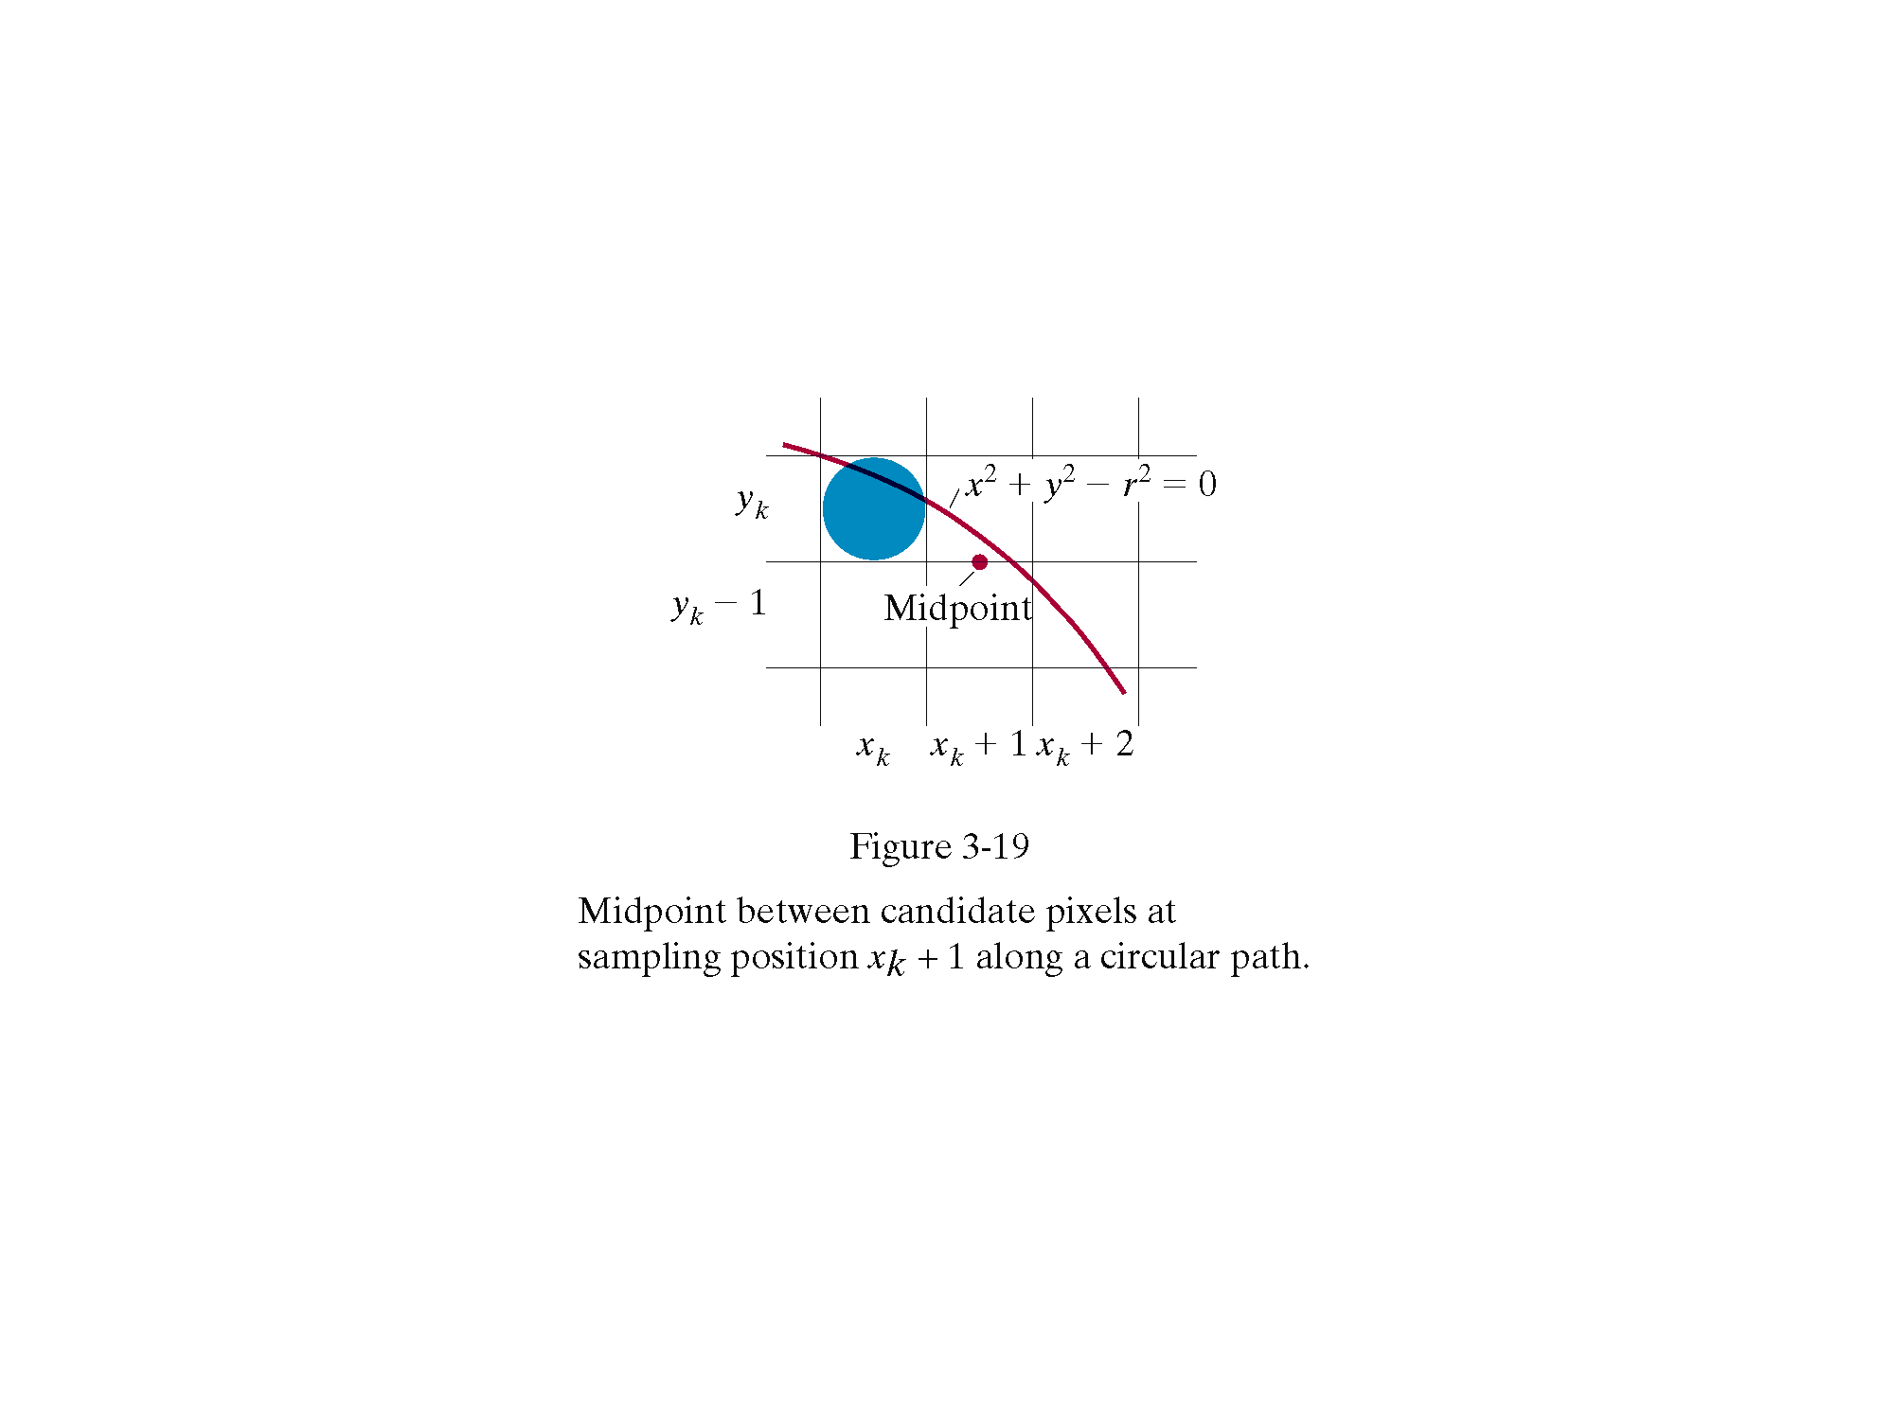
Midpoint coordinates are

Slide 15
Assuming we have just plotted point at (xk,yk) we determine whether move E or SE by evaluating the circle function at the midpoint between the two candidate pixel positions
pk is the decision variable
if pk <0 the midpoint is inside the circle
Thus the pixel above the midpoint is closer to the ideal circle, and we select pixel on scan line yk. i.e. Go E

Slide 16
If pk >0 the midpoint is outside the circle.
Thus the pixel below the midpoint is closer to the ideal circle, and we select pixel on scan line yk-1. i.e. Go SE
Calculate successive decision parameter values p by incremental calculations.

Slide 17
recursive definition for successive decision parameter values p
Where yk+1 = yk if p<0 (move E)
yk+1 = yk-1 if p>0 (move SE)
yk+1 and xk+1 can also be defined recursively

Slide 18
Initialisation
x₀ = 0, y₀ = r
Initial decision variable found by evaluating circle function at first midpoint test position
For integer radius r p₀ can be rounded to p₀ =1-r
since all increments are integer.

Slide 19
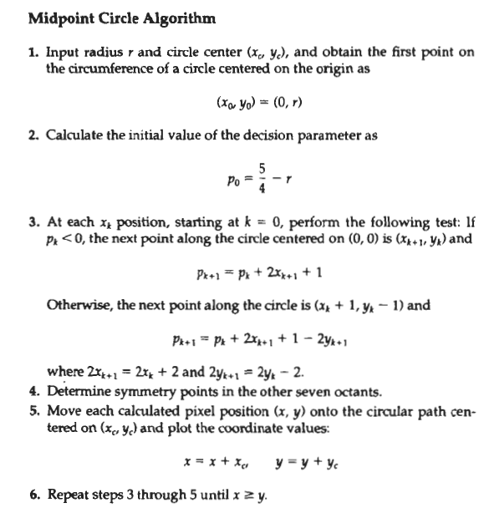

Slide 20
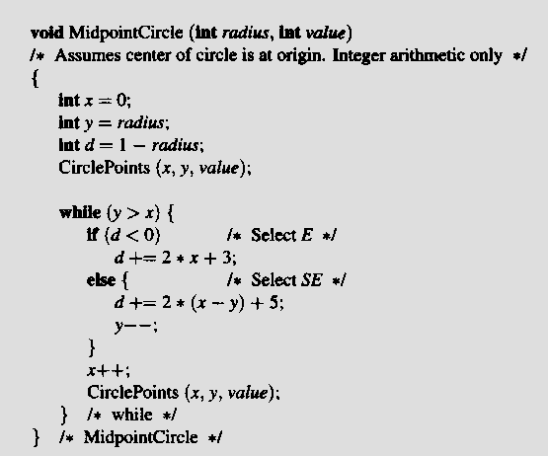
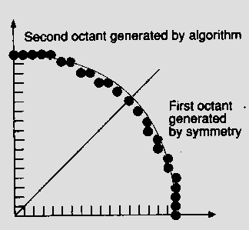
Midpoint Circle Algorithm (cont.)

Slide 21
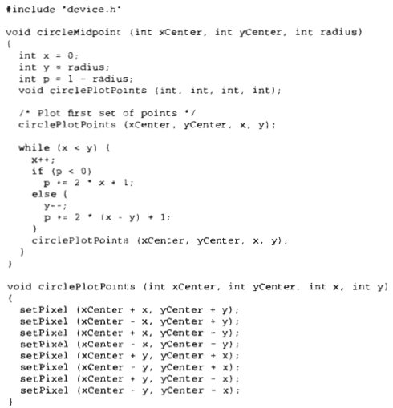
Midpoint Circle Algorithm (cont.)

Slide 22
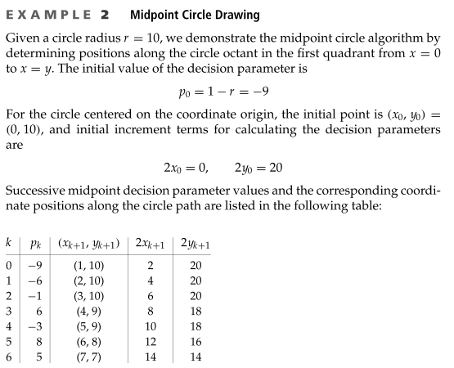
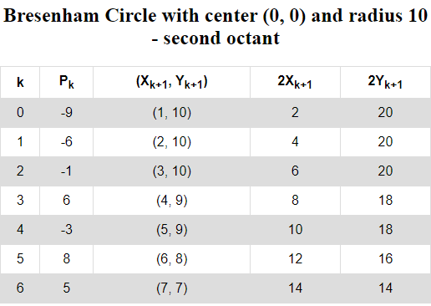

Slide 23
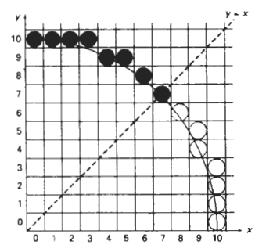
Example
r=10

